Slide 1

Stage 1 Look What They Did To My Stage Course Designer: Setup Crew & Marcel Englmaier
Look What They Did To My Stage is a 21 round, 105 point Comstock Long course. There are 10 USPSA targets and 1 steel target. The best two hits per target will score. Steel must fall to score. The start signal is audible.
The Handgun start position is standing with heels touching either set of marks and wrists below belt. Handgun loaded and holstered. The PCC start position is standing with heels touching either set of marks. PCC loaded with stock touching belt and muzzle pointed down range.
On the audible start signal, engage all targets from within the shooting area.

Slide 2
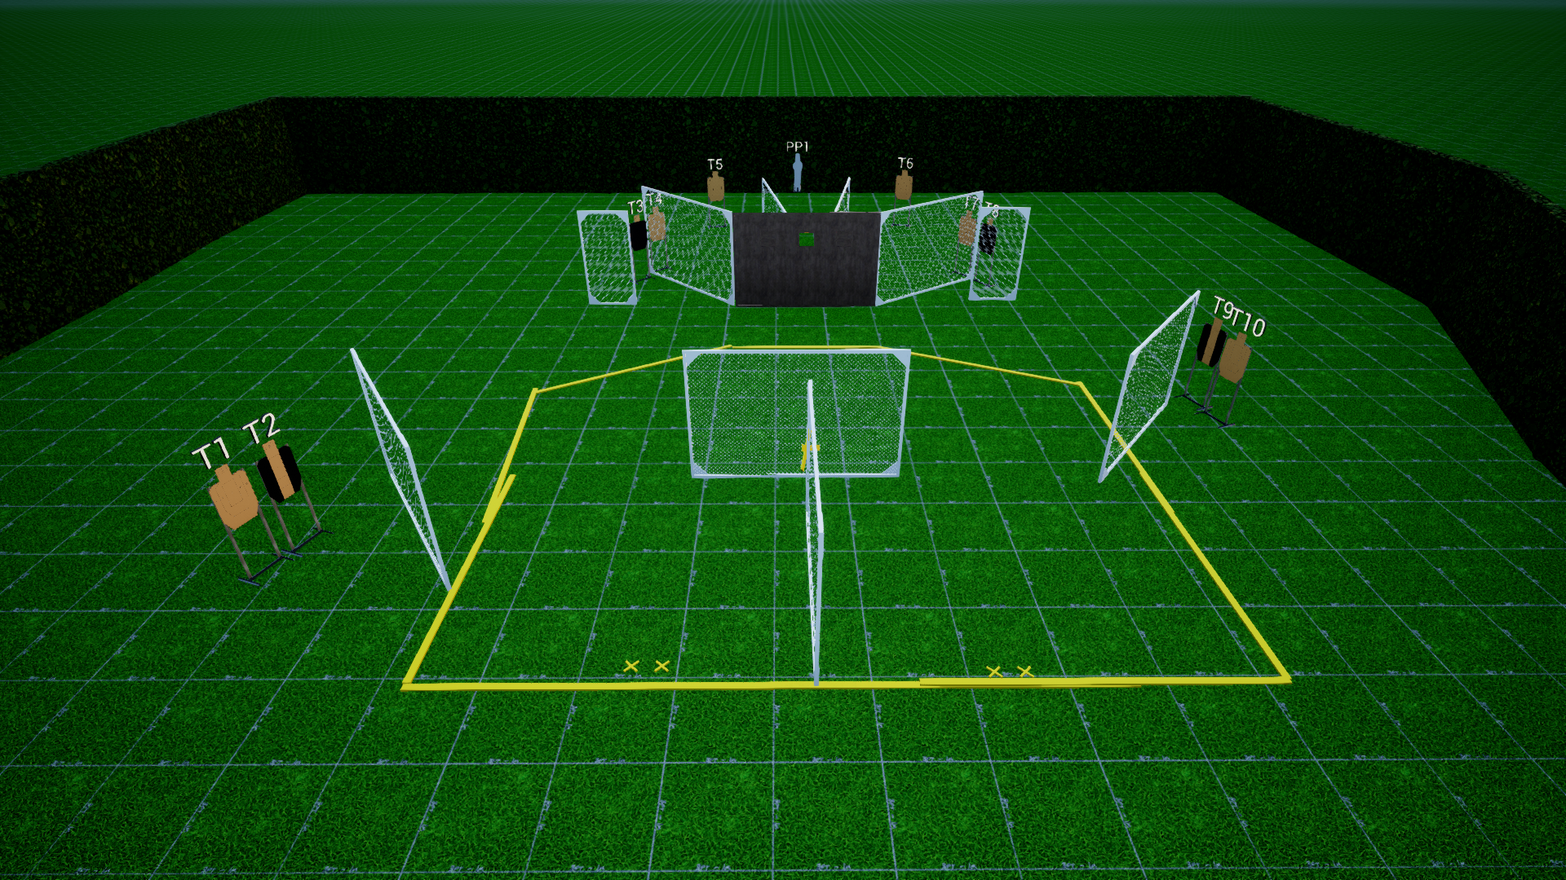
 | Stage 1 A Tale of Three Three Windows Course Designer: Marcel Englmaier

